Slide 1



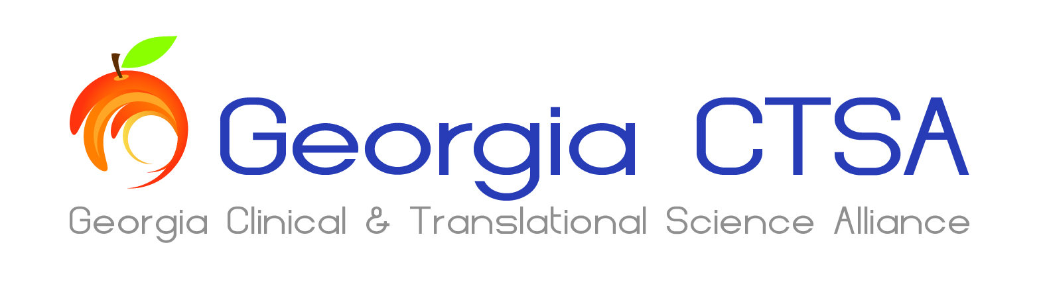
Making Waves: The Impact of the Georgia CTSA Publication
Portfolio from 2007-2020
Do Big Splashes lead to Ripple Effects on Translation?
Nicole M. Llewellyn, PhD, Amber A. Weber, MPH, & Eric J. Nehl, PhD
Georgia CTSA Evaluation & Continuous Improvement Program
Notes:
Hi everyone. I am Nikki Llewellyn, from the Evaluation and Continuous Improvement program of the Georgia CTSA, along with Amber Weber and Eric Nehl from ECI, I’m presenting a project entitled: Making Waves: The Impact of the Georgia CTSA Publication Portfolio from 2007-2020, where we ask the question: Do publications that make a Big Splash lead to Ripple Effects on Translation

Slide 2
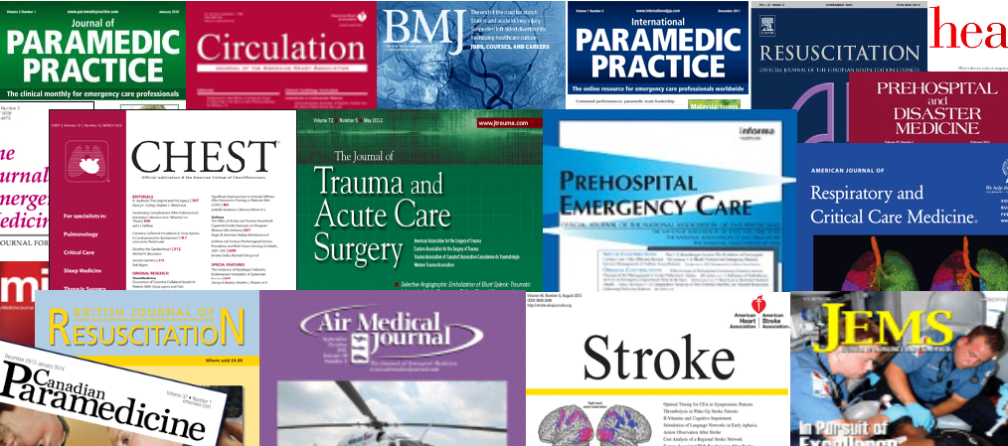



2019 Research Day
2021 Southeast Regional Clinical & Translational Science Conference
Purpose:
  Evaluate publication activity since transition from ACTSI to Georgia CTSA & move beyond traditional publication analyses by incorporating altmetrics:
    The influence of published research in non-academic spheres such as media, community, patents and policy
Prior research:
  Little relationship between altmetrics and academic citations.
  No one has examined this in clinical/translational science, or used more modern citation impact factors, e.g. NIH’s Relative Citation Ratio
  Unclear whether any relationship between altmetric attention and citation is due to publication in higher impact journals
Notes:
The Evaluation & Continuous Improvement program regularly assesses the Georgia CTSA publication portfolio in 2016, finding a robust, diverse, and highly impactful portfolio compared to similar CTSA hubs. In this update, we evaluate progress made since 2016, with the important addition of novel altmetrics, or influence of published research in non-academic spheres such as media, community, patents and public policy

Slide 3
2019 Research Day
2021 Southeast Regional Clinical & Translational Science Conference
Goal:
  Evaluate the Georgia CTSA’s advancement in publication and citation activity, and altmetric indicators of translational impact
  Test the hypothesis that early altmetric indicators of Big Splash publications predict citation Ripple Effects, independent of the journal’s impact
Method:
  For all publications acknowledging support from Georgia CTSA grants, we collected Altmetric Attention Scores (AAS) and Relative Citation Ration (RCR) values from Dimensions, and Journal Impact Factor (JIF) values from Web of Science
Notes:
More waves, diagram the hypothesis

Slide 4
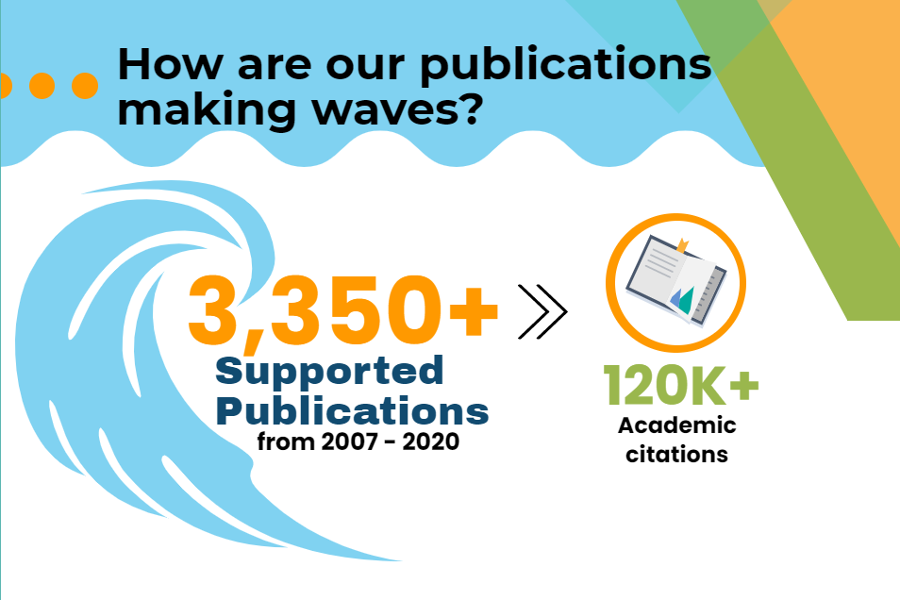
2019 Research Day
2021 Southeast Regional Clinical & Translational Science Conference
Notes:
Tsunami of publications, coming out at a pretty steady rate across the grant
Relative Citation Ratio of 2.3: articles have been cited an average of 2.3 times as often as other articles from the same year & field

Slide 5
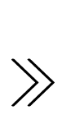
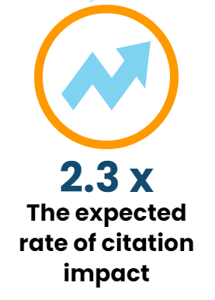
2019 Research Day
2021 Southeast Regional Clinical & Translational Science Conference
Notes:
Tsunami of publications, coming out at a pretty steady rate across the grant
Relative Citation Ratio of 2.3: articles have been cited an average of 2.3 times as often as other articles from the same year & field

Slide 6
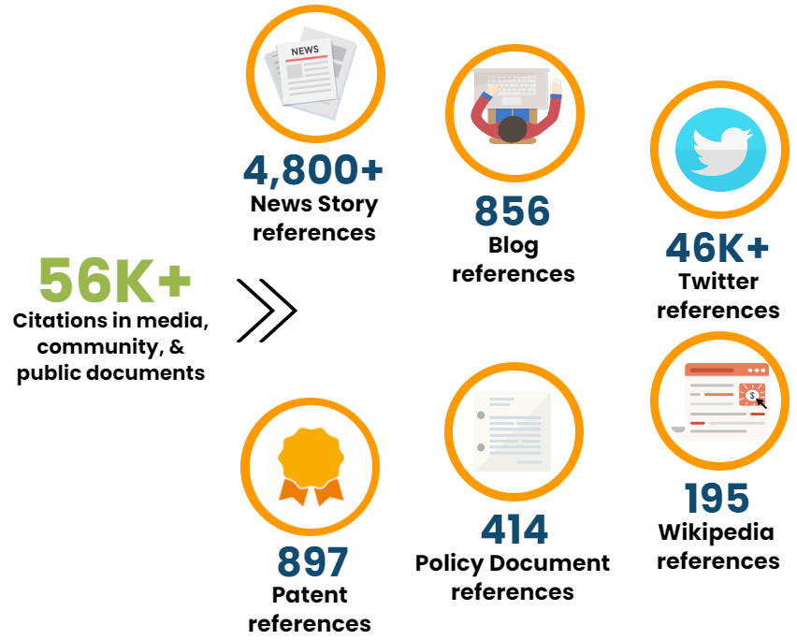
2019 Research Day
2021 Southeast Regional Clinical & Translational Science Conference
Notes:
Tsunami of publications, coming out at a pretty steady rate across the grant
Relative Citation Ratio of 2.3: articles have been cited an average of 2.3 times as often as other articles from the same year & field

Slide 7

2019 Research Day
2021 Southeast Regional Clinical & Translational Science Conference
Big Splashes DO lead to Ripple Effects on Translation
  AAS, JIF, & RCR were all positively correlated with one another
  Consistent with our hypothesis, hierarchical multiple regression showed that AAS does predicts RCR, even after controlling for the albeit larger effect of JIF.
AAS
β= .18***
RCR
β= .4***
Jif
β= .37***
Notes:
Get correlation effect sizes, standardized betas?
In the second part of our analysis, we asked whether Big splash articles with more altmetric attention have ripple effects through increased citation influenc, and we found that yes they do. Within the Georgia CTSA’s portfolio Altmetric Scores, RCR citation scores and Journal Impact scores were all positively correlated with one another, and using hierarchical multiple regression analyses, we found that Altmetric attention does significantly predict citation impact, which is not entirely driven by publication in higher impact journals. Considering that JIF scores are derived from how many citations their papers get, we’re not surprised that there is also a big effect of the journal impact factor on the RCR citation score.

Slide 8
2019 Research Day
2021 Southeast Regional Clinical & Translational Science Conference
Conclusion: Within the Georgia CTSA publication portfolio, public/community attention, such as references in news stories, tweets, and blogs, in addition to publication in high impact journals, heightens articles’ ability to achieve wider use and citation influence, opening the door to translational advancement.
Notes:
We see this as evidence for a chain of events where translatable research is supported by the CTSA, that research is published in academic journals, some that are very high impact, those publications are then discussed and referenced in both academic and non-academic and community forums, and the more that happens the more likely they are to be used and cited in subsequent research, which we think opens the door to moving medical science forward toward usable, technological, & translational advancement.

